Slide 1
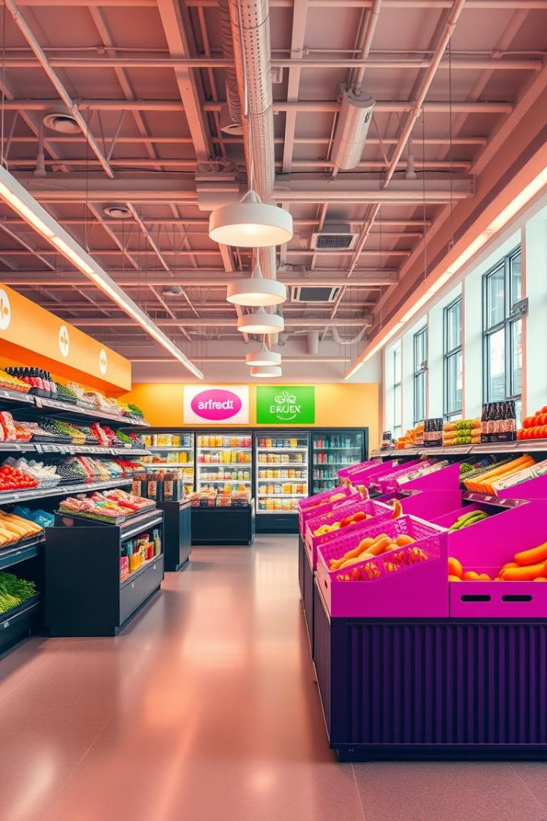
Grocery Webapp Using MERN Stack
BY
Veniyan U [211521104176]
Sujith Antony F [211521104162]
Snegan V [211521104151]
Sivakumar R [211521104147]
Notes:
1

Slide 2
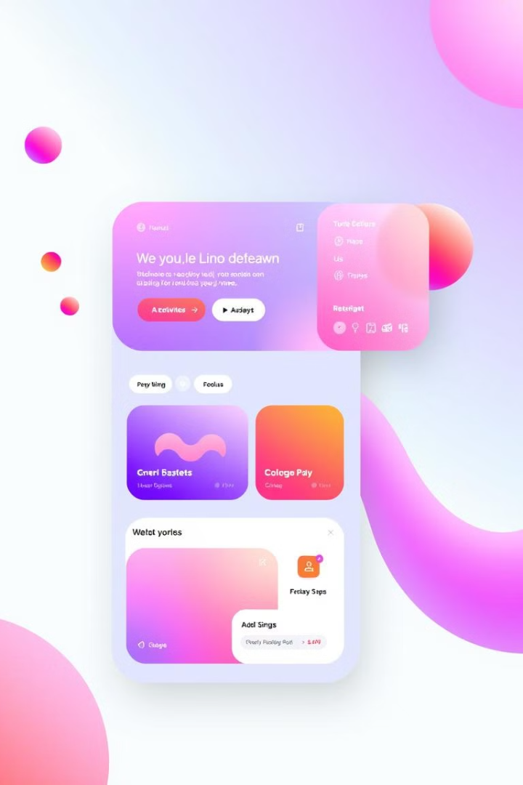
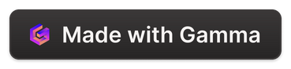
Abstract
Our MERN-based grocery webapp aims to revolutionize the online shopping experience. By leveraging the power of the MERN stack, we've developed a seamless, user-friendly platform that streamlines grocery ordering, delivery, and management.
Notes:
2

Slide 3
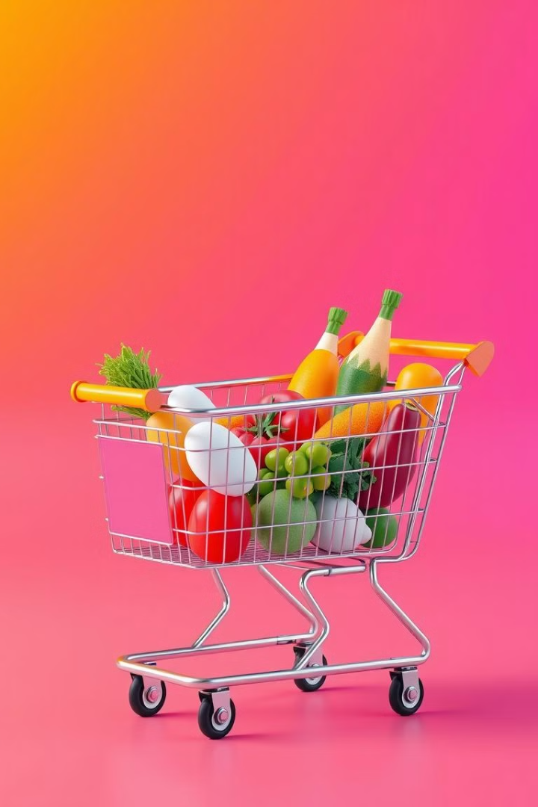
Introduction
1
Convenient Online Grocery Shopping
2
Personalized Shopping Experience
Customers can browse and order groceries from the comfort of their homes, with options for delivery or in-store pickup.
The webapp provides tailored recommendations and order history to enhance the shopping experience.
Notes:
3

Slide 4
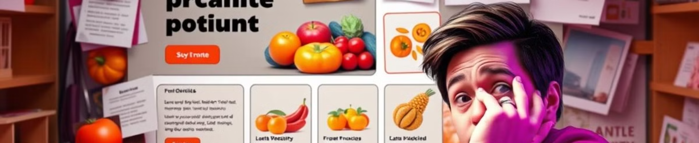
Existing System and Drawbacks Of Existing System
Limited Functionality
Complicated Ordering Process
Many existing grocery webapps offer a narrow range of features, lacking in personalization and convenience.
Existing systems often have a complex, time-consuming checkout process, deterring customers.
Notes:
4

Slide 5
Proposed System And Advantages Of Proposed System
Seamless User Experience
Personalized Recommendations
Our MERN-based webapp provides a streamlined, intuitive interface for an enjoyable shopping experience.
The system leverages machine learning to offer personalized product recommendations based on user preferences and purchase history.
Notes:
5

Slide 6
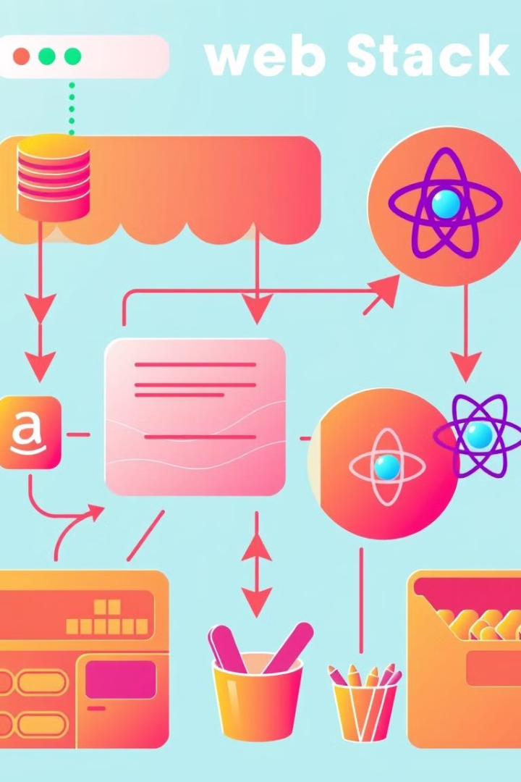
Architecture Diagram And Module
Modular Design
Secure and Reliable
Our architecture follows a modular approach, allowing for scalability and easy maintenance.
The MERN stack ensures a secure and reliable platform for handling sensitive customer data and transactions.
Notes:
6

Slide 7
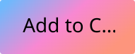
Sample Code
// React Component
import React from 'react';
const ProductCard = ({ product }) => {
return (
{product.name}
{product.description}
Price: {product.price}
); }; export default ProductCard;
Notes:
7

Slide 8
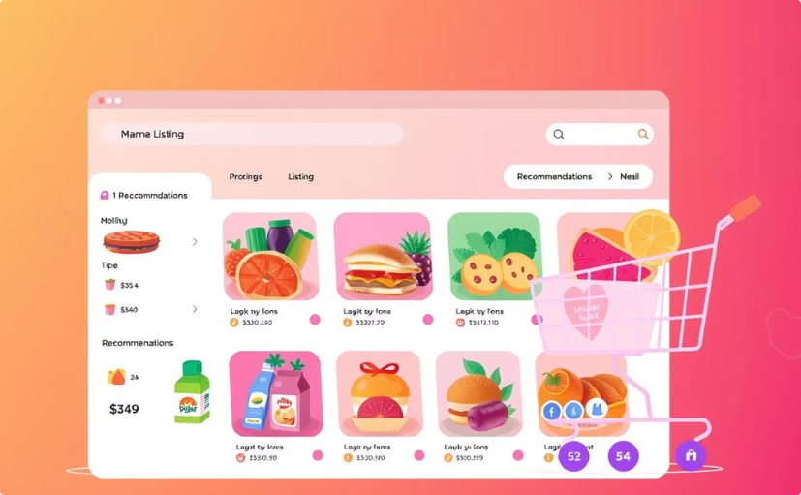
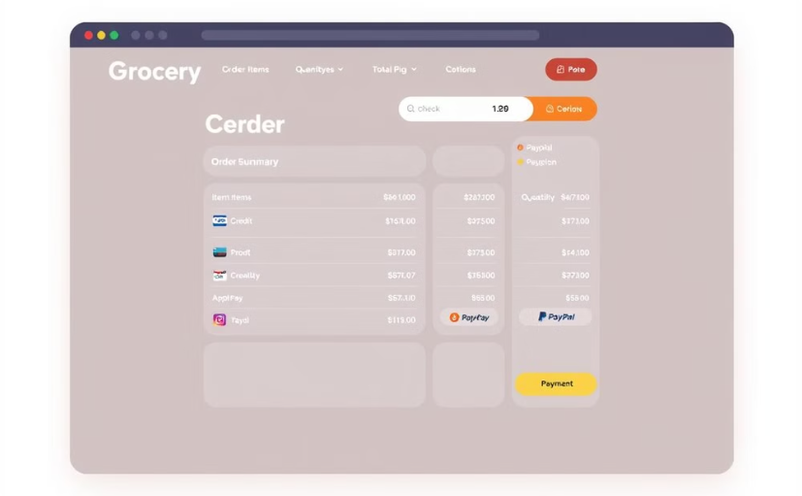
Output Screenshots
Product Listing
Seamless Checkout
Users can browse and add products to their cart.
The checkout process is streamlined and user-friendly.
Notes:
8

Slide 9
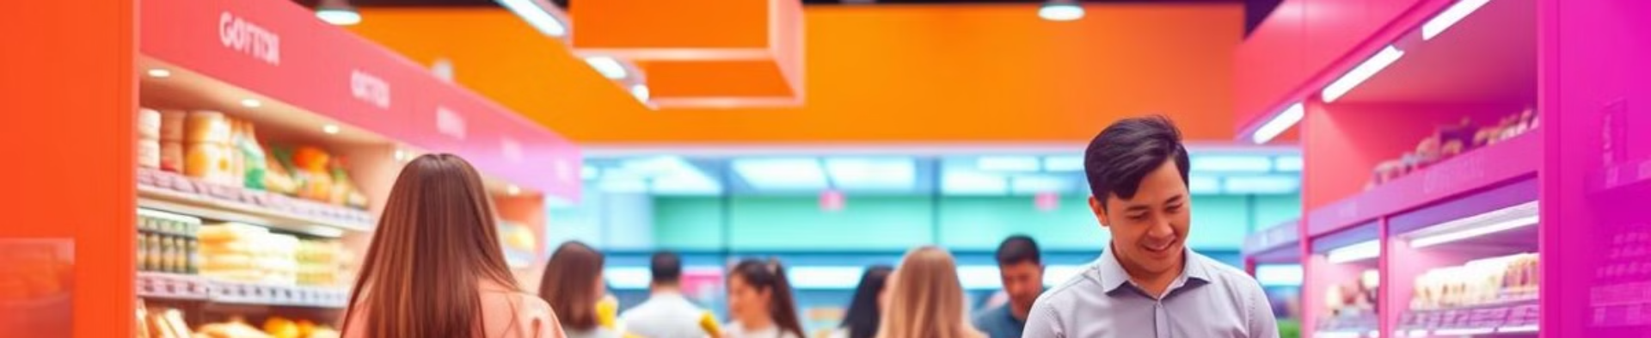
Conclusion
Transformative Shopping Experience
Proven Technology Stack
Our MERN-based grocery webapp revolutionizes the online shopping experience, providing customers with a seamless, personalized, and convenient platform.
The MERN stack ensures a secure, scalable, and reliable solution that can adapt to the evolving needs of the grocery industry.
Notes:
9

Slide 10
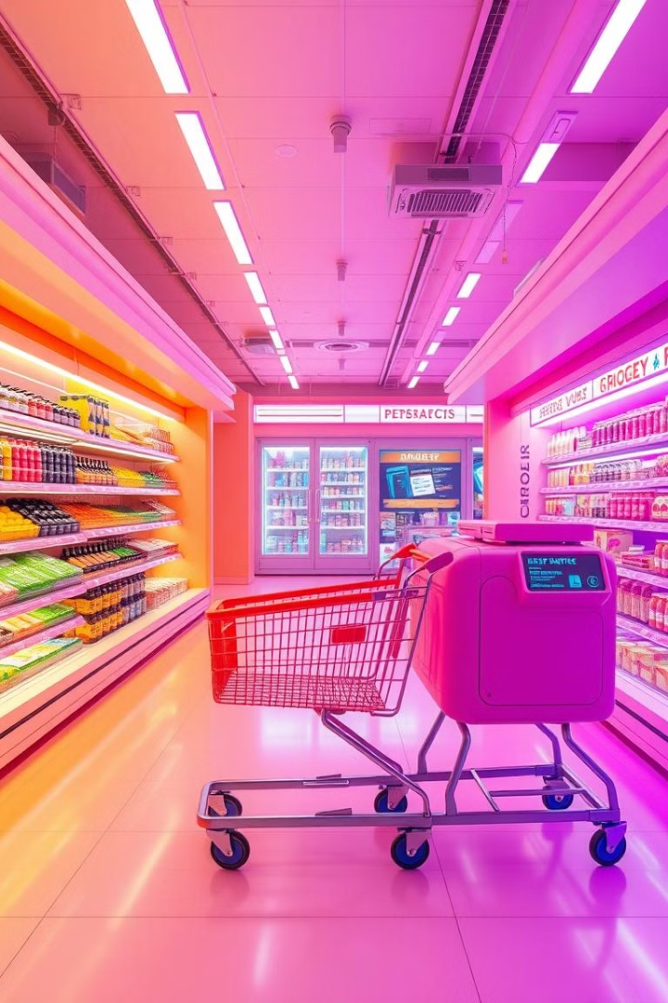
Future Enhancements
Intelligent Recommendations
1
Leverage advanced machine learning algorithms to provide even more accurate and tailored product recommendations.
Voice-Controlled Shopping
2
Implement voice recognition technology to allow hands-free product search and ordering.
Autonomous Delivery
3
Explore the integration of self-driving delivery vehicles to provide faster and more efficient grocery delivery.
Notes:
10

